Slide 1




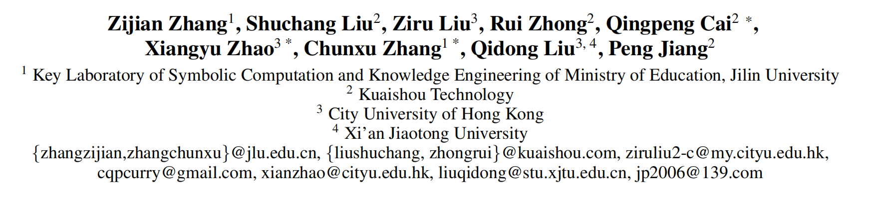





ATAI
Advanced Technique of Artificial Intelligence
ATAI
ChongqingUniversity _{AdvancedTechniqueof}
of Technology Artificial Intelligence
Chongqing University of
Technology
Chongqing University ^{ATAI}
_{of Technology} Advanced Techniqueof
Artificial Intelligence
Chongqing University of Technology
Chongqing University of Technology
LLM-Powered User Simulator for Recommender System
Code:https://github.com/Applied-Machine-Learning-Lab/LLM_User_Simulator
——AAAI_2025
Reported by Cong Sheng
1

Slide 2
ATAI
Advanced Technique of Artificial Intelligence
ATAI
ChongqingUniversity _{AdvancedTechniqueof}
of Technology Artificial Intelligence
Chongqing University of
Technology
Chongqing University ^{ATAI}
_{of Technology} Advanced Techniqueof
Artificial Intelligence
Chongqing University of Technology
Chongqing University of Technology
Motivation
Research background: Reinforcement Learning (RL)-based recommender systems are crucial for capturing user preferences and long-term engagement. However, they require abundant interactive data, which is costly to collect and raises privacy concerns.
Current simulators’ key challenges:
1) Current simulators lack explicit user preference modeling, leading to opaque and unpredictable behavior.
2)There is no effective evaluation framework to measure the fidelity of simulated interactions against real user behavior.
3)While LLMs offer strong semantic understanding, their direct use introduces high computational costs and hallucination risks.
Goal: To develop an interpretable, efficient, and reliable user simulator that combines LLM-powered logical reasoning with statistical stability for transparent and faithful user behavior simulation.

Slide 3
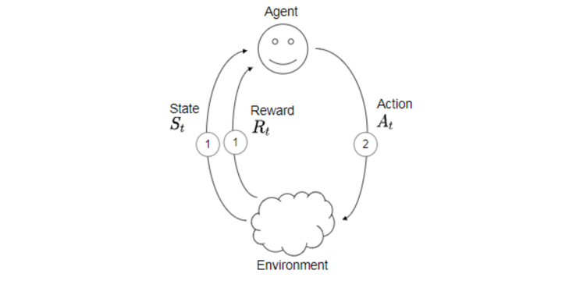
ATAI
Advanced Technique of Artificial Intelligence
ATAI
ChongqingUniversity _{AdvancedTechniqueof}
of Technology Artificial Intelligence
Chongqing University of
Technology
Chongqing University ^{ATAI}
_{of Technology} Advanced Techniqueof
Artificial Intelligence
Chongqing University of Technology
Chongqing University of Technology
MDP Formulation in recommender system
Agent: The recommender system.
Environment: user interaction and preference.
State : the set of all possible states of the environment.
Action : the set of all possible actions the system can take, where an action represents one recommended item ic.
Reward: assigns a numerical reward to each transition from state s to s′ by action ic.
Goal: Maximize long-term interactions with users.
Policy: The method of choosing actions to achieve goals.

Slide 4
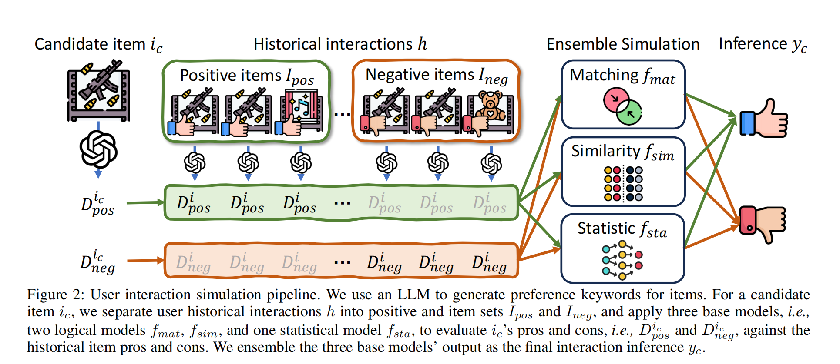
ATAI
Advanced Technique of Artificial Intelligence
ATAI
ChongqingUniversity _{AdvancedTechniqueof}
of Technology Artificial Intelligence
Chongqing University of
Technology
Chongqing University ^{ATAI}
_{of Technology} Advanced Techniqueof
Artificial Intelligence
Chongqing University of Technology
Chongqing University of Technology
Overview

Slide 5
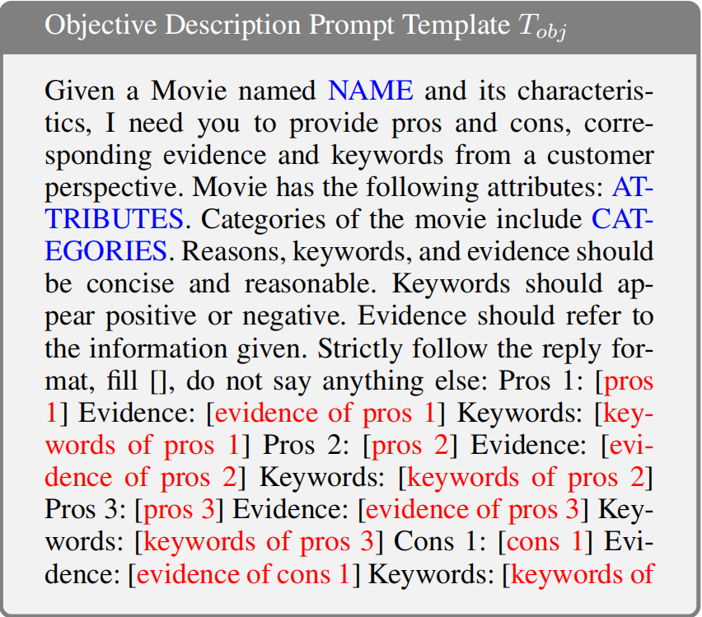
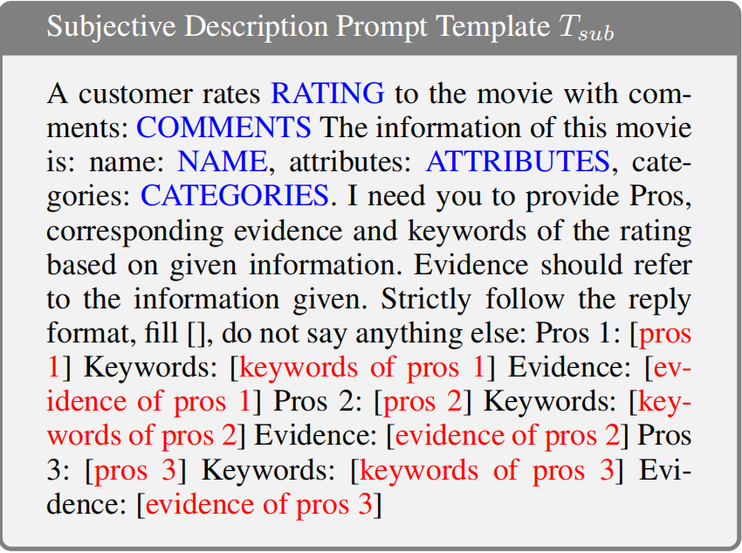
ATAI
Advanced Technique of Artificial Intelligence
ATAI
ChongqingUniversity _{AdvancedTechniqueof}
of Technology Artificial Intelligence
Chongqing University of
Technology
Chongqing University ^{ATAI}
_{of Technology} Advanced Techniqueof
Artificial Intelligence
Chongqing University of Technology
Chongqing University of Technology
Method

Slide 6
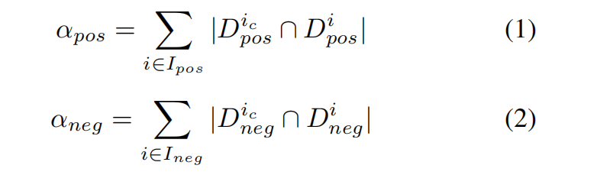
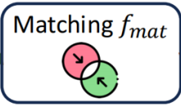
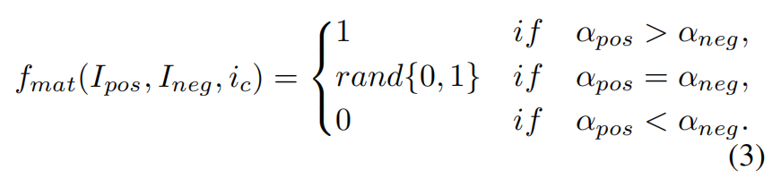

ATAI
Advanced Technique of Artificial Intelligence
ATAI
ChongqingUniversity _{AdvancedTechniqueof}
of Technology Artificial Intelligence
Chongqing University of
Technology
Chongqing University ^{ATAI}
_{of Technology} Advanced Techniqueof
Artificial Intelligence
Chongqing University of Technology
Chongqing University of Technology
Method

Slide 7
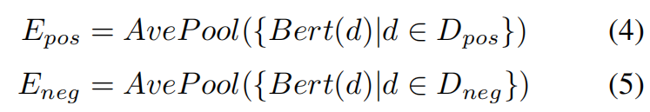
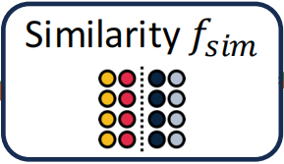
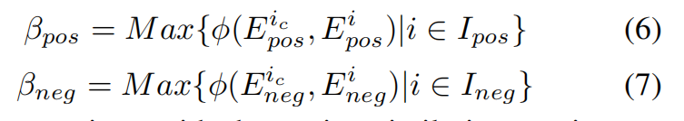

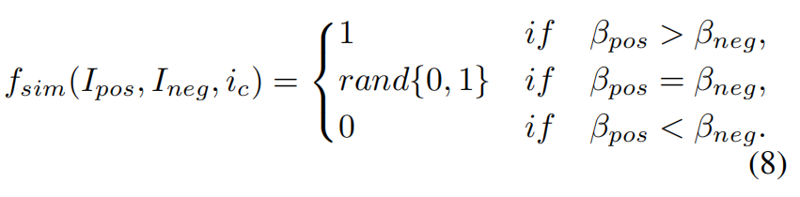
ATAI
Advanced Technique of Artificial Intelligence
ATAI
ChongqingUniversity _{AdvancedTechniqueof}
of Technology Artificial Intelligence
Chongqing University of
Technology
Chongqing University ^{ATAI}
_{of Technology} Advanced Techniqueof
Artificial Intelligence
Chongqing University of Technology
Chongqing University of Technology
Method

Slide 8
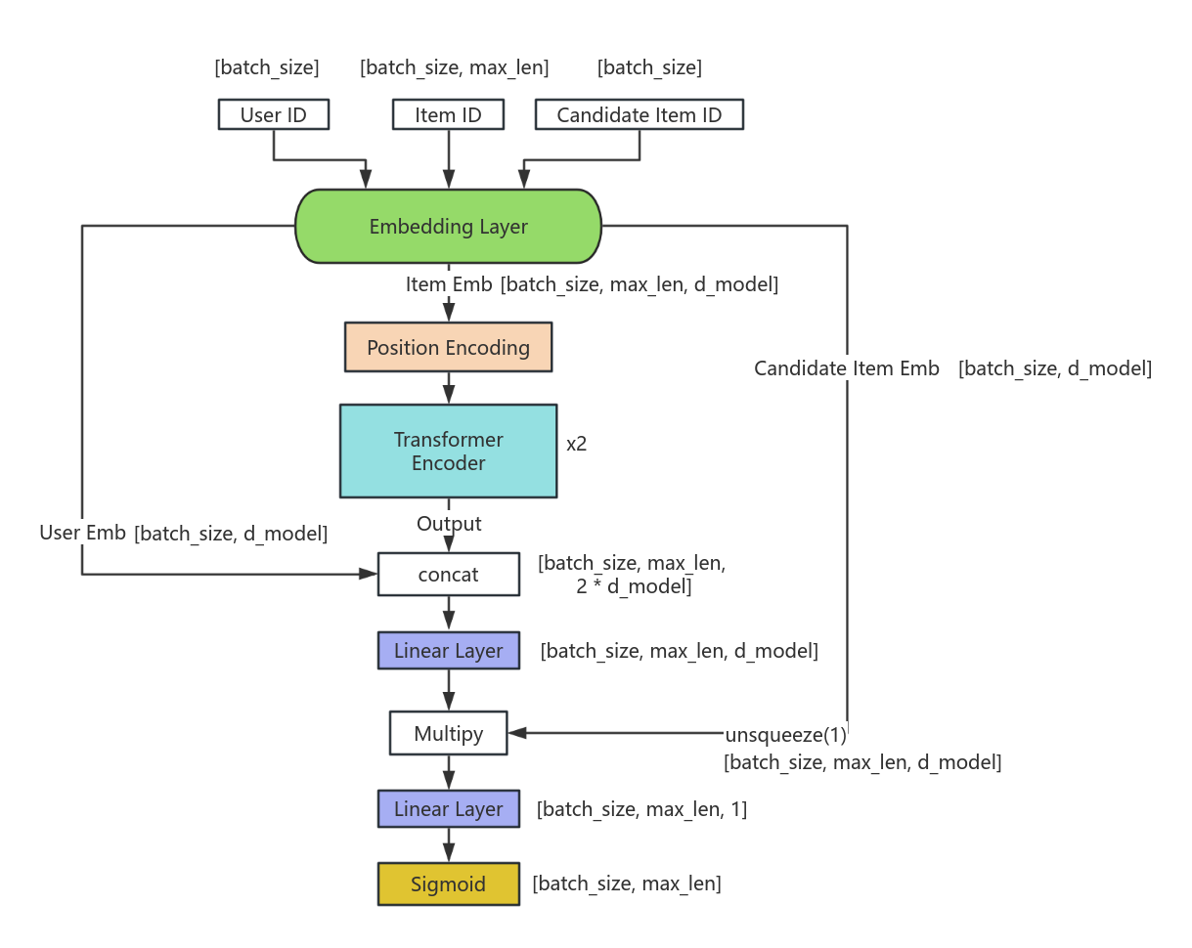
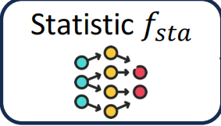

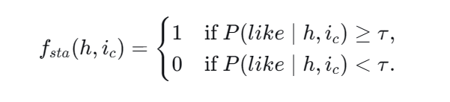
ATAI
Advanced Technique of Artificial Intelligence
ATAI
ChongqingUniversity _{AdvancedTechniqueof}
of Technology Artificial Intelligence
Chongqing University of
Technology
Chongqing University ^{ATAI}
_{of Technology} Advanced Techniqueof
Artificial Intelligence
Chongqing University of Technology
Chongqing University of Technology
Method

Slide 9
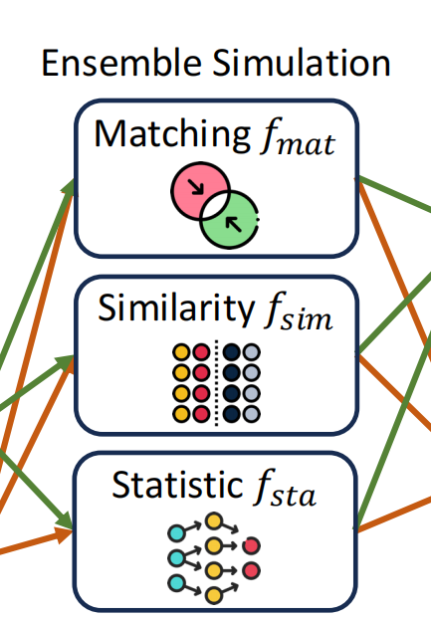
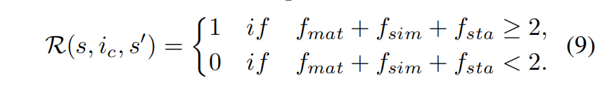

ATAI
Advanced Technique of Artificial Intelligence
ATAI
ChongqingUniversity _{AdvancedTechniqueof}
of Technology Artificial Intelligence
Chongqing University of
Technology
Chongqing University ^{ATAI}
_{of Technology} Advanced Techniqueof
Artificial Intelligence
Chongqing University of Technology
Chongqing University of Technology
Method
Reward Function (R(s, ic, s′ )): assigns a numerical reward to each transition from state s to s ′ by action ic.
We craft an ensemble model to serve as the user simulator, and the reward function is determined by the consensus reached among three constituent base models, which could be formulated as Eq. 9:

Slide 10
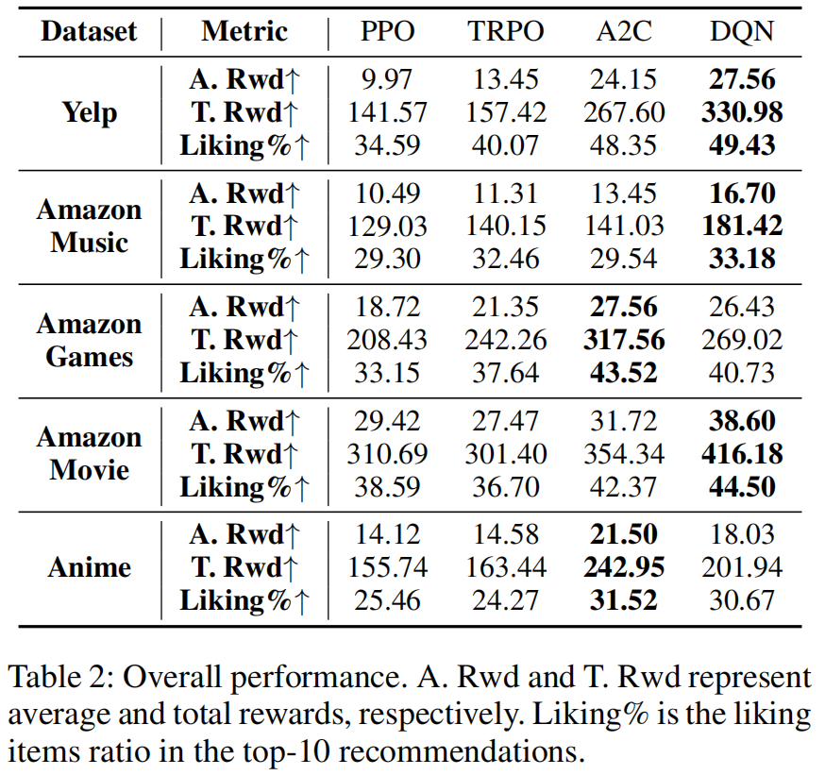
ATAI
Advanced Technique of Artificial Intelligence
ATAI
ChongqingUniversity _{AdvancedTechniqueof}
of Technology Artificial Intelligence
Chongqing University of
Technology
Chongqing University ^{ATAI}
_{of Technology} Advanced Techniqueof
Artificial Intelligence
Chongqing University of Technology
Chongqing University of Technology
Experiments

Slide 11
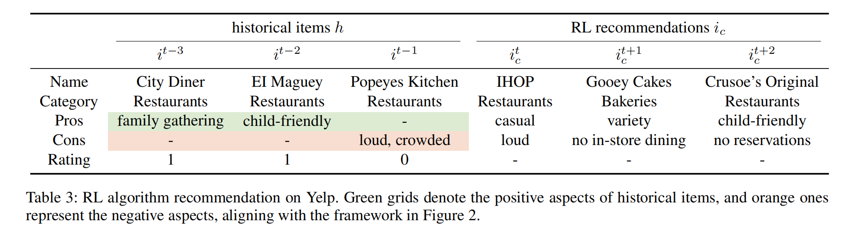
ATAI
Advanced Technique of Artificial Intelligence
ATAI
ChongqingUniversity _{AdvancedTechniqueof}
of Technology Artificial Intelligence
Chongqing University of
Technology
Chongqing University ^{ATAI}
_{of Technology} Advanced Techniqueof
Artificial Intelligence
Chongqing University of Technology
Chongqing University of Technology
Experiments

Slide 12

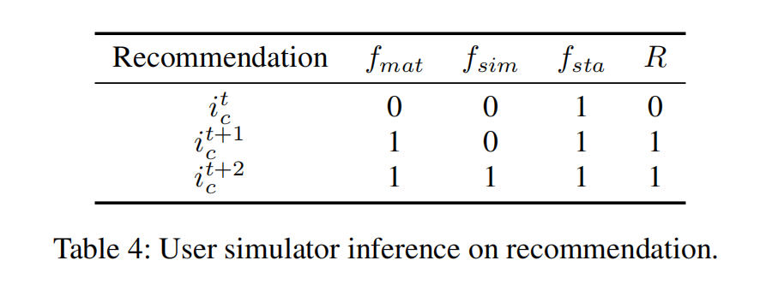
ATAI
Advanced Technique of Artificial Intelligence
ATAI
ChongqingUniversity _{AdvancedTechniqueof}
of Technology Artificial Intelligence
Chongqing University of
Technology
Chongqing University ^{ATAI}
_{of Technology} Advanced Techniqueof
Artificial Intelligence
Chongqing University of Technology
Chongqing University of Technology

Slide 13
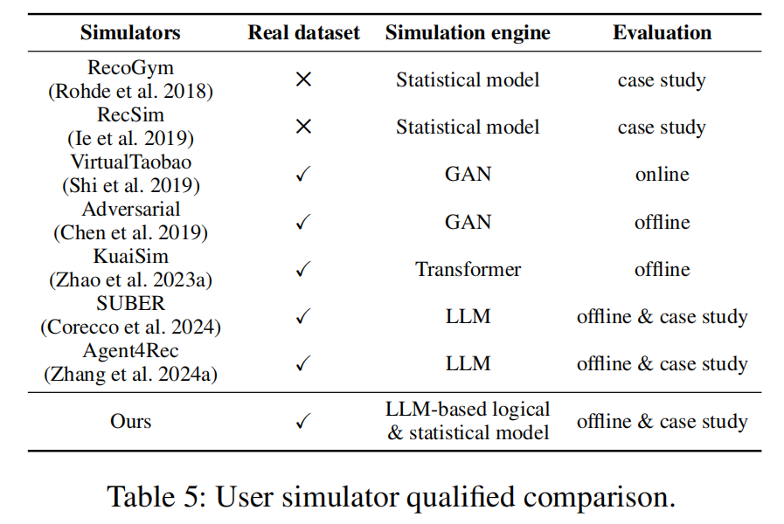
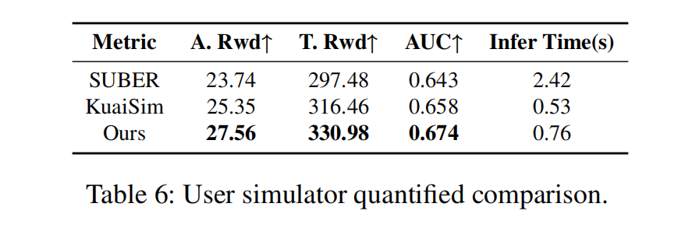
ATAI
Advanced Technique of Artificial Intelligence
ATAI
ChongqingUniversity _{AdvancedTechniqueof}
of Technology Artificial Intelligence
Chongqing University of
Technology
Chongqing University ^{ATAI}
_{of Technology} Advanced Techniqueof
Artificial Intelligence
Chongqing University of Technology
Chongqing University of Technology

Slide 14


ATAI
Advanced Technique of Artificial Intelligence
ATAI
ChongqingUniversity _{AdvancedTechniqueof}
of Technology Artificial Intelligence
Chongqing University of
Technology
Chongqing University ^{ATAI}
_{of Technology} Advanced Techniqueof
Artificial Intelligence
Chongqing University of Technology
Chongqing University of Technology
Thanks!

